Slide 1
Yazdani Jamsheed
Ceylan Ender
Juarez Addison
Part 2

Slide 2
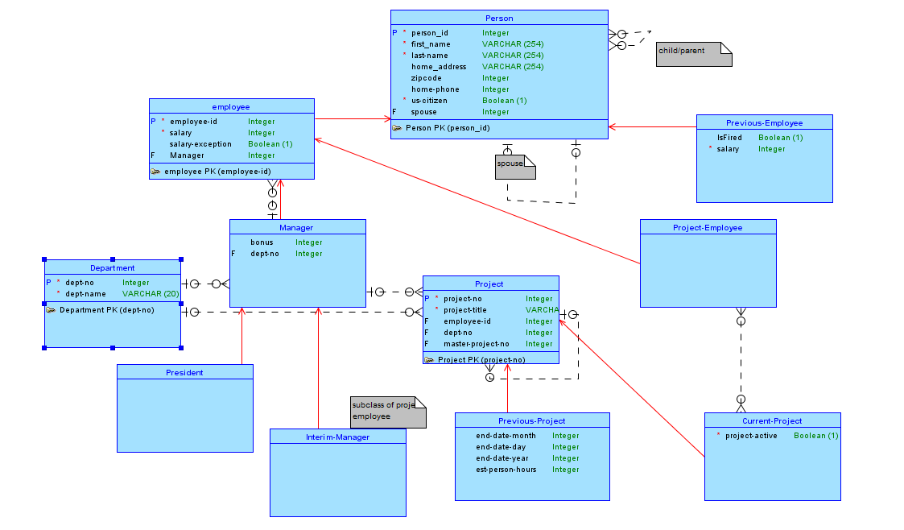
Conceptual Model

Slide 3
Git repo
https://github.com/enderceylan/S16E1_DataManagementProject

Slide 4
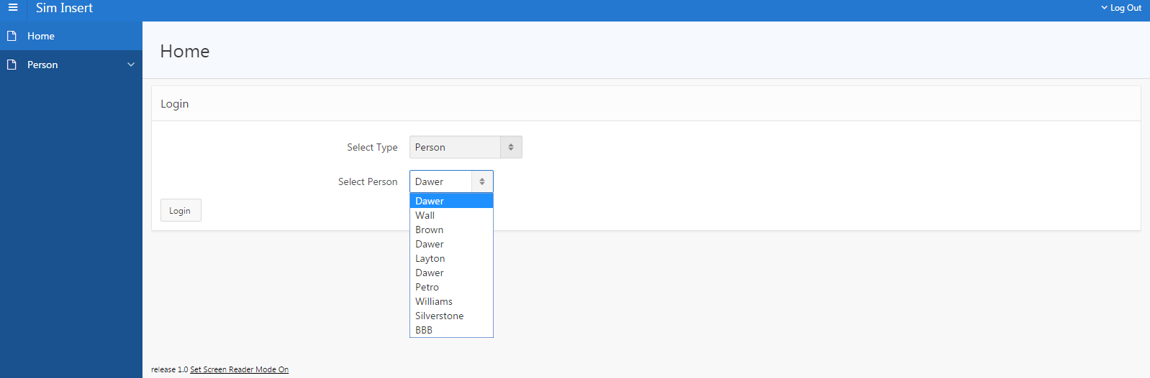
Login Page

Slide 5
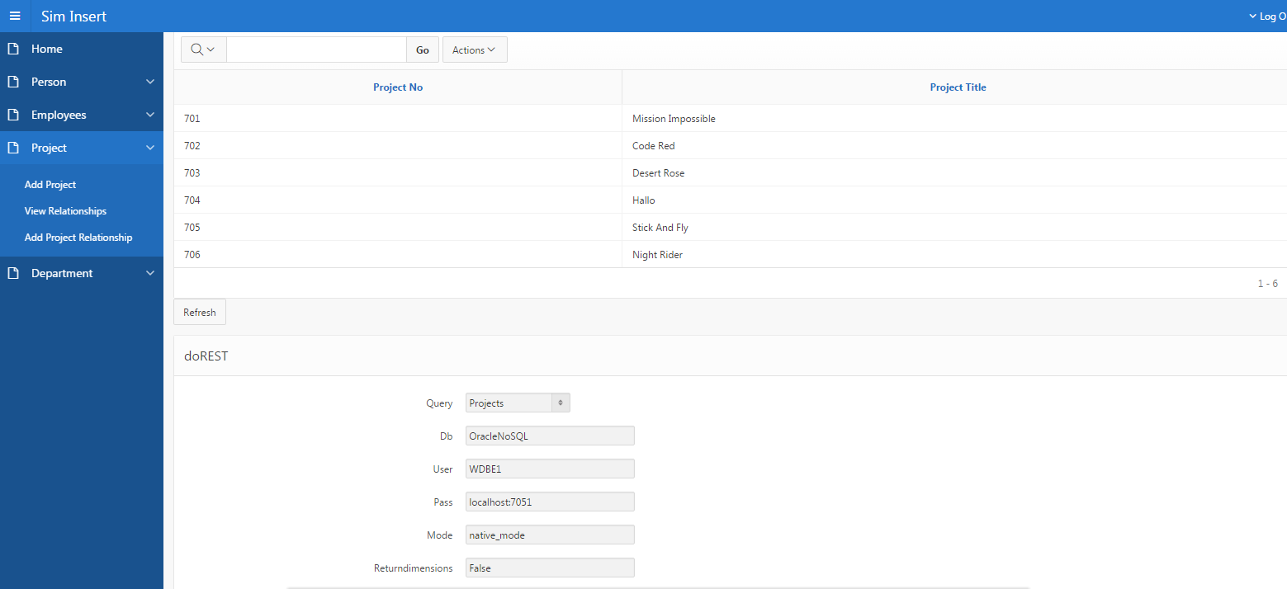
Form and Report

Slide 6
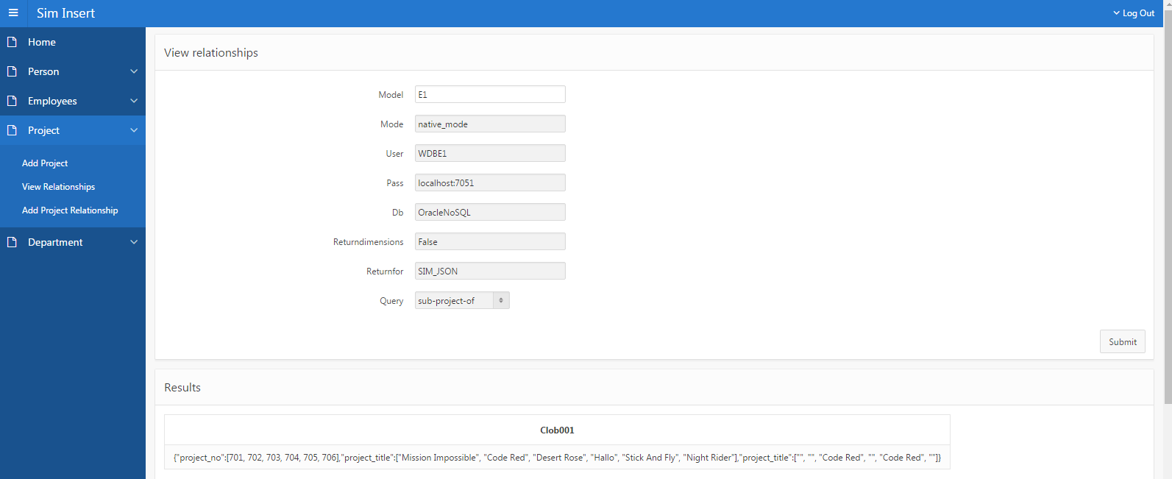
Relationships

Slide 7
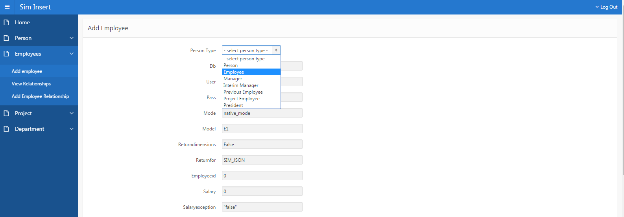
Add Class Form

Slide 8
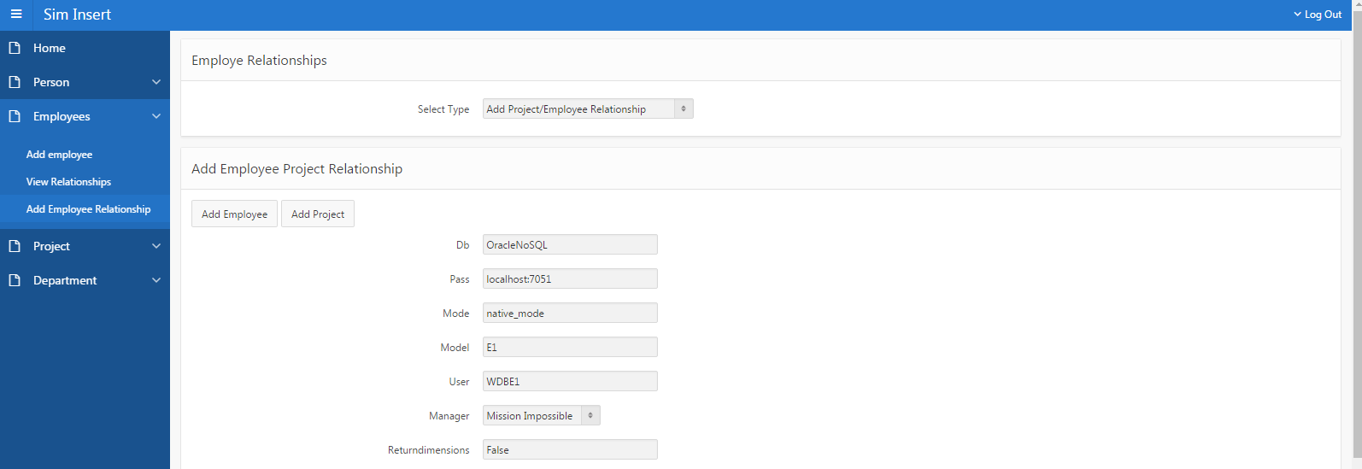
Add Relationships

Slide 9
SIM DDL
Cleaned up Bo Li Thesis Example.carnot.sim

Slide 10
APEX URL
https://apex.oracle.com/pls/apex/f?p=1051:1:111135899442851:::::

